Slide 1
IBM Data Science Certificate
Capstone Project

Slide 2
Introduction
The problem that is going to be analyzed is the distribution and ratings of Italian restaurants in Toronto, Ontario, Canada.
The targeted audience is a prospective restaurateur that would like to open an Italian restaurant in Toronto. The specific answer we are trying to ascertain is whether a restauranteur should open an Italian restaurant in Toronto. This will be based on determining how many Italian Restaurants are currently in Toronto and how those existing restaurants are distributed across Toronto’s neighborhoods.

Slide 3
Data
The data that will be used for this analysis included population statistics for Toronto as well as Foursquare data related to the distribution and rating of Italian restaurants in Toronto. Additionally, neighborhood data for Toronto will be uploaded into the analysis to help determine neighborhood related distribution.

Slide 4
Methodology
Imported all necessary python libraries.
Imported Toronto neighborhood data
Determined geographical location data for Toronto
Imported Foursquare credentials
Created a map of Toronto that highlighted neighborhoods
Conducted Foursquare search of Italian Restaurants
Explored Results of Foursquare search
Retrieved ratings for all Italian Restaurants in Toronto
Plotted all Italian Restaurants on Toronto Map
Plotted all Italian Restaurants on Toronto Map with Neighborhood

Slide 5
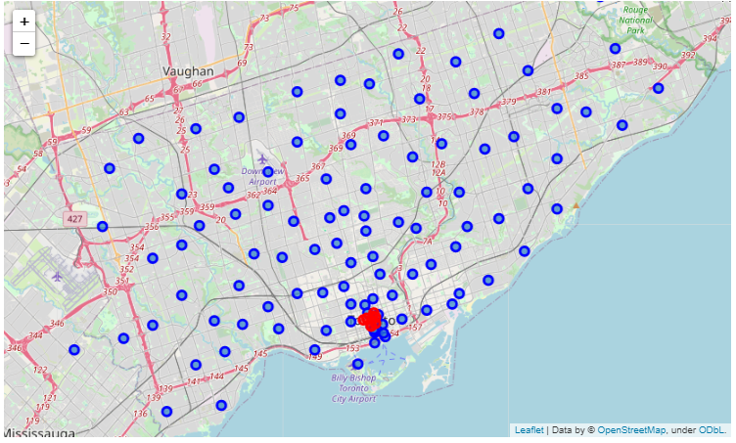
Results
Toronto Neighborhoods (blue) underserved by Italian Restaurants (red)

Slide 6
Discussion
Foursquare provides insufficient data to provide recommendation.
But if only this information is used, Toronto needs more Italian restaurants.
Additional analysis could be conducted of similar cities to provide additional context

Slide 7
Conclusion
To answer the most basic question of whether a restaurateur should open an Italian restaurant in Toronto, the answer appears to be Yes. Overall, there was one Italian restaurant per 366,000 residents in Toronto, which indicates that it is an underserved market. Further, there were significantly more neighborhoods than Italian restaurants throughout Toronto, which highlights that there were significant portions of the city without an Italian eatery.

